Slide 1
Reading for Critical Thinking
Grace
Visiting Scholar
California State University, Fullerton

Slide 2
Overall Goal
Develop critical thinking through critical reading

Slide 3
Agenda
Definitions
Theories
Strategies
Application

Slide 4
Definitions

Slide 5
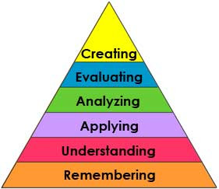
What is Critical Thinking?
Bloom(1956) terms critical thinking as the ability to gain knowledge through the exploration of ideas concerning the following six levels.

Slide 6
What is Critical Reading?
Think- Pair-Share:
Finish the sentence “Critical Reading is …” on the top of the poster
Pair discussion
share to class

Slide 7
What is Critical Reading?
Critical reading is active reading. The reader must question, compare, and evaluate reading material.

Slide 8
Theories

Slide 9
A little bit of theories
Bloom’s Taxonomy
The Delphi Report

Slide 10
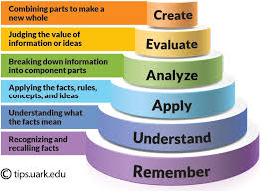
Bloom’s Taxonomy
The three highest levels are frequently said to represent critical thinking

Slide 11
The Delphi Report (1990)
critical thinking to be purposeful, self-regulatory judgment

Slide 12
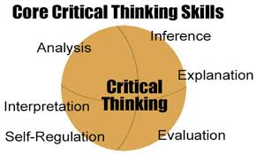
Critical Thinking Skills

Slide 13
Dispositions toward Critical Thinking
Open-minded
Analytic
Systematic
Inquisitive
Judicious
Truth-seeking
Confident in reasoning

Slide 14
Strategies

Slide 15
7 Critical Reading Strategies
Previewing
Contextualizing
Questioning
Reflecting
Outlining and Summarizing
Evaluating
Comparing and Contrasting

Slide 16
1. Previewing
Learning about a text before really reading it.
Enable to get a sense of what the text is about, what it is organized.

Slide 17
2. Contextualizing
Placing a text in its historical, biographical, and cultural contexts.
Help to recognized the differences between your contemporary values and attitude.

Slide 18
3. Questioning
Asking questions about the content or the author.
Help to understand and remember the text.

Slide 19
4. Reflecting
Examining your personal responses
Help to challenge to your beliefs and values.

Slide 20
5. Outlining and summarizing
Identifying the main ideas and restating them in your own words.
Help to reveals the basic structure of the text and synopsizes a selection's main argument in brief.

Slide 21
6. Evaluating
Testing the logic of a text as well as its credibility and emotional impact.
Help to recognize every assertion as an argument

Slide 22
7. Comparing and contrasting
Exploring likenesses and differences between texts to understand them better.
Help to recognize the similarity and difference.

Slide 23
Think-Pair-share
Which two are the most important? Why?
1. Previewing 2. Contextualizing
3. Questioning 4. Reflecting
5. Outlining and summarizing 6. Evaluating
7. Comparing and contrasting

Slide 24
Application

Slide 25
“Charles”
by Shirley Jackson

Slide 26
Objectives
The students will:
analyze the story
evaluate the character
Summarize the story
question the author

Slide 27
Teaching Procedures
Step I Previewing (the first reading)
Skim to get an overview of the content and organization (the first reading)
then fill in the first two columns of KWL chart

Slide 28
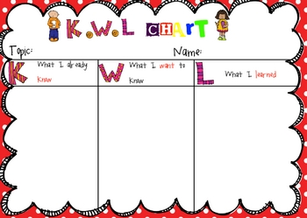
K: What I know about Laurie?
W: What I want to know about Laurie?

Slide 29
Step II Analyzing and evaluating
(the second reading)
1. Answer the Text-Dependent Questions
2. Create Questions according to Bloom’s Taxonomy

Slide 30
Text-Dependent Questions
1. What is this text about? (Understanding)
2. What does the author help you to understand mother’s reaction? (Key details)
3. What does the author help you to understand Laurie’s attitude towards Charles? (Text structure)
4. What is the author’s purpose in writing this text? (Author purpose)
5. What can you infer from Laurie and Charles? (Inference)
6. Why did Laurie do that thing—making up Charles? (Opinion, argument, evaluation)

Slide 31
Create questions according to Bloom’s Taxonomy
Remember | recall information
Understand | demonstrate comprehension and understanding
Application | use of information and concepts, solve problems
Analysis | see patterns, reorganize ideas, find hidden meanings
Evaluation | assess value, draw conclusion, recommend
Create | combine ideas in new ways, invent new ways of seeing, doing, or thinking

Slide 32
Step III Summarizing and reflecting
Group activities: Using 10 important words for summarizing
1. Select 10 important words from the text
2. Compare with group
3. Develop new list that all agree on
4. Write a several sentences using the words to summarize the story

Slide 33
Questioning the Author
Initiate Discussion
Focus on message
Link information
Identify difficulties
Encourage students to refer to text
Encourage critical reflection
1. What is the author trying to say?
2.That is what the author said, but what is the overall message?
3. How does that connect with what the author already told us?
4.What needs to be figured out?
5.Did the author tell us that?
6.Did you like the story? Why?
7.What could the author have done differently?

Slide 34
Step IV Reviewing
Fill in the last column of KWL chart
L: What I learn about Laurie?

Slide 35
Thank you!

