Slide 1
Critical Thinking & Interpreting Class ——from practical perspective
By Penny

Slide 2
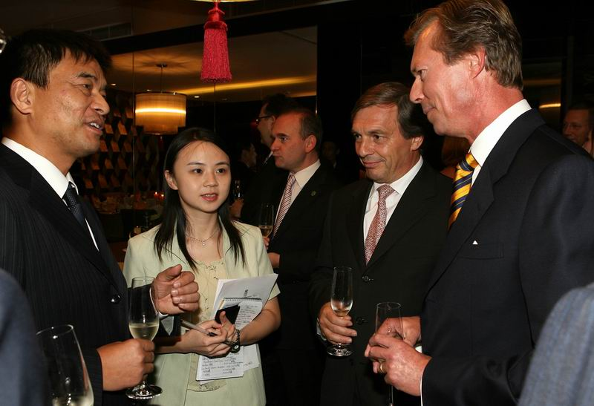
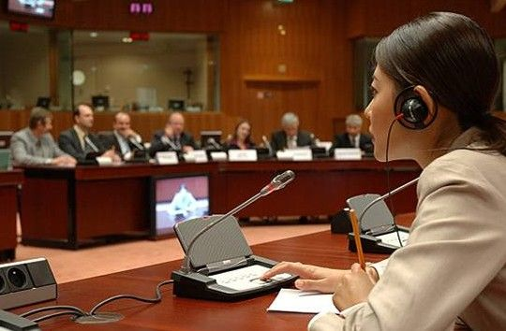
Features of Interpreting Practice
oral
communicative
cross-cultural
impromptu
nerve-racking
single-handed
situational
flexible
resourceful

Slide 3
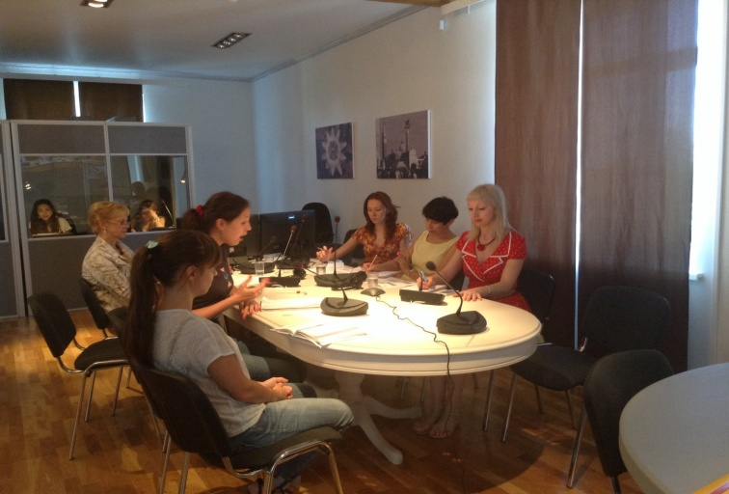
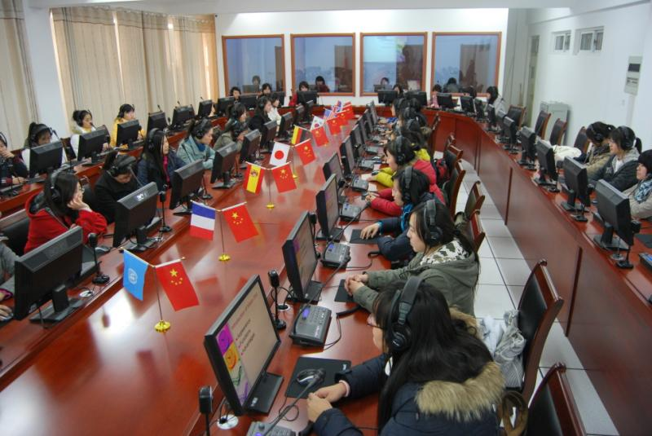
Features & Requirement of Interpreting Class
small class
simulative situation
intense atmosphere
independent thinking
critical thinking
reflective thinking

Slide 4
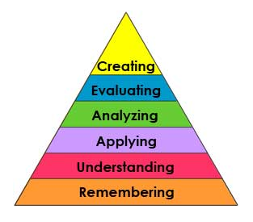
Bloom’s Taxonomy
six cognitive levels
six levels of intellectual behavior in learning

Slide 5
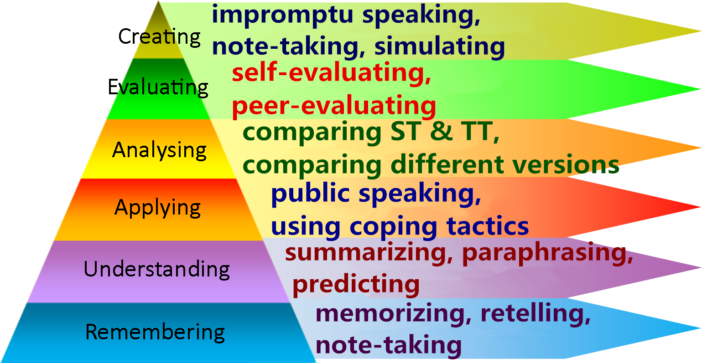
Critical Thinking & Interpreting
*ST: Source Text; TT: Target Text

Slide 6
Activities to Develop Critical Thinking in Interpreting Class (1)
Remembering:
retelling exercise
note-taking exercise
vocabulary brainstorming

Slide 7
Activities to Develop Critical Thinking in Interpreting Class (2)
Understanding:
summarizing exercise
predicting exercise
paraphrasing exercise

Slide 8
Activities to Develop Critical Thinking in Interpreting Class (3)
Applying
public speaking practice
utilizing coping tactics
utilizing paraphrasing skills

Slide 9
Activities to Develop Critical Thinking in Interpreting Class (4)
Analyzing:
explaining culture-specific terms
comparing different interpretation versions
comparing source text & reference translation

Slide 10
Activities to Develop Critical Thinking in Interpreting Class (5)
Evaluating
peer evaluating
self evaluating
writing retrospective report

Slide 11
Activities to Develop Critical Thinking in Interpreting Class (6)
Creating:
impromptu speaking
presentation
simulative liaison interpreting
mock conference interpreting

Slide 12
Teaching Design for an Interpreting Class (1)
Course Title: Interpreting between English and Chinese
Lesson Title: Ceremonial Speeches
Length of Lesson: 120 minutes
Student Level: junior students in college

Slide 13
Teaching Design for an Interpreting Class (2)
Objectives:
1. to enhance students' skills of public speaking, memorizing and paraphrasing (develop different levels of critical thinking skills);
2. to get students familiar with the style and expressions of speeches in public events and ceremonies

Slide 14
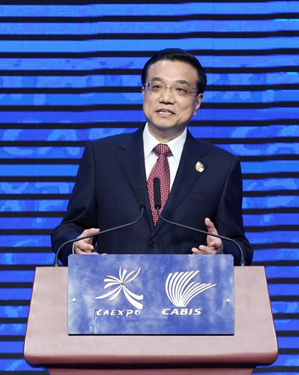
Teaching Design for an Interpreting Class (3)
Materials:
1.Chinese speech (Excerpted remarks at the 10th CAEXPO and CABIS by Li Keqiang, Premier of the State Council of China )

Slide 15
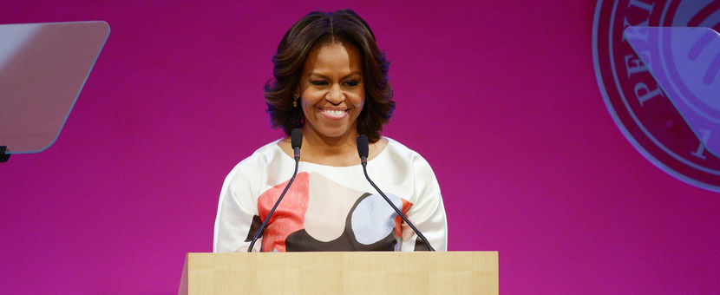
Teaching Design for an Interpreting Class (4)
Materials:
2. English speech (Excerpted remarks by Michelle Obama, First Lady of the United States at Peking University)

Slide 16
Teaching Design for an Interpreting Class (5)
Procedure:
1. Lead-in and warm-up activity of pair speaking (10mins)
2. Public speaking, retelling and peer evaluation (25mins)
3. Chinese-English interpreting and paraphrasing (40mins)
4. English-Chinese interpreting and peer evaluation (35mins)
5. Task assignment for next week (10mins)

Slide 17
Step 1 (10mins) .
Lead-in and warm-up activity of pair speaking——have students do pair-work of speaking in English with topics given a week ago for preparing
Welcome Speech
Opening/Closing Speech
Banquet Toast

Slide 18
Step 2 (25mins) .
Public speaking, retelling and peer evaluating——
have volunteer students deliver the English speeches in front of the class
call other students to retell the speeches
have students do peer evaluation with given rubrics on public speaking performance

Slide 19
Step 3 (40mins) .
Chinese-English interpreting and paraphrasing——
read out the excerpted Chinese speech segment by segment
call students to interpret the same segment with different versions by utilizing paraphrasing skills
have students compare different versions of interpreting

Slide 20
Step 4 (35mins).
English-Chinese interpreting and peer evaluation——
play the audio/video clip of English speech for students to interpret into Chinese segment by segment
call some students to interpret to the whole class for peer evaluation with rubrics on interpreting performance

Slide 21
Step 5 (10mins) .
Assignment: prepare for the mock conference in next week
The whole class is divided into four groups:
Conference Organizers (including conference host, conference secretary, Chinese speaker and English speaker)
Interpreters
Journalists
Assessors

Slide 22
Task of conference organizers:
to prepare for all the affairs of the conference such as
fixing up the classroom for conference;
getting the notes or PPT ready for hosting and speaking;
rehearsing for procedure and time management.

Slide 23
Task of interpreters :
to prepare for the impromptu interpreting by searching information related to the conference theme, predicting contents of the speech and collecting relevant vocabulary;
to write retrospective report for self evaluation with detailed analysis.

Slide 24
Task of journalists:
to prepare questions related to the conference theme;
to raise the questions after the speakers have made the speeches;
to take videos of the conference and make editing afterwards.

Slide 25
Task of assessors:
to observe the whole process of the conference;
to take notes and assess the performance of the other three groups;
to write evaluation report from observers’ point of view after the conference.

